Slide 1

Company Bankruptcy Prediction Classification
Ms. Swati Zambre
Learnbay Institute
Advanced AI & ML Batch
Welcome to the Presentation!
Notes:
A Warm Welcome to everyone who have joined the kickoff meeting of Omdena India Chapters First Ever Local Challenge - Leveraging Ai to Analyse the Socio Economic Impact of Covid19 In India

Slide 2
Agenda
Problem statement
Project workflow and pipeline
Data Collection Phase
Modelling Phase
Deployment Phase

Slide 3
Company Bankruptcy
Bankruptcy :
A legal process in which an individual or business declares their inability to repay their debts
It is usually a last resort for individuals and businesses who are overwhelmed by their financial obligations and have exhausted all other options for debt relief.
Corporate Bankruptcy:
A legal process in which a company declares its inability to pay its debts and seeks protection from its creditors.
Reasons:
Market Conditions
Financing
Poor Decision making
Other Causes

Slide 4
Common Causes of Bankruptcy
Medical bills
Unemployment
Business failure
Lack of financial planning
Divorce
Disasters
Accidents
Reduced income
Credit debt
© 2019, Federal Reserve Bank of St. Louis. Permission is granted to reprint or photocopy this presentation in its entirety for educational purposes provided the user credits the Federal Reserve Bank of St. Louis, www.stlouisfed.org/education.

Slide 5
Consequences & Negative Effects
of Bankruptcy
Recorded on a credit report
May prevent renting an apartment
May prevent obtaining a loan
May trigger higher interest rates
May harm personal & business relationships
May hinder employment opportunities
Lowers a credit score
© 2019, Federal Reserve Bank of St. Louis. Permission is granted to reprint or photocopy this presentation in its entirety for educational purposes provided the user credits the Federal Reserve Bank of St. Louis, www.stlouisfed.org/education.

Slide 6
Types of Bankruptcy
Voluntary Bankruptcy: A bankruptcy petition filed in federal court by the distressed firm’s management.
Involuntary Bankruptcy: A bankruptcy petition filed in federal court by the distressed firm’s creditors.
Chapter 7 bankruptcy: A company's assets are liquidated to pay off creditors, and the company ceases operations.
Chapter 13 bankruptcy: Similar to Chapter 11, but designed for small businesses.
Chapter 11 bankruptcy: The company reorganizes its debts and operations under court supervision, with the goal of emerging as a financially viable entity.
Receivership: A court-appointed receiver takes control of the company and manages its assets to pay off creditors.
Assignment for the benefit of creditors: The company assigns its assets to a third-party trustee who liquidates the assets and distributes the proceeds to the company's creditors.

Slide 7
How Bankruptcy Affects Investors
Bankruptcy can have a significant impact on investors, depending on the circumstances surrounding the bankruptcy. Here are some of the ways in which bankruptcy can affect investors:
Loss of investment
Delayed or reduced returns
Changes in ownership structure
Uncertainty and volatility
Legal proceedings
Overall, bankruptcy can have significant implications for investors, and it is important for investors to carefully evaluate the risks associated with investing in companies that may be at risk of bankruptcy.

Slide 8
How Do Bankruptcy Costs Affect a Company's Capital Structure
Increased debt
Decreased equity
Limited access to capital
Higher cost of capital
Overall, bankruptcy costs can have a significant impact on a company's capital structure. Companies that are considering bankruptcy should carefully evaluate the potential costs and the impact that these costs may have on their financial position and their ability to raise capital in the future.

Slide 9
Company Bankruptcy
The Taiwan Economic Journal for the years 1999 to 2009 has listed the details of company bankruptcy based on the business regulations of the Taiwan Stock Exchange.
The Taiwan Stock Exchange was established in 1961 and began operating as a stock exchange on 9 February 1962.
It is a financial institution located in Taipei, Taiwan. It has over 900 listed companies.
The data includes a majority of numerical attributes that help understand the possibility of bankruptcy.
This project aims at analyzing the possibility of whether an organization would face bankruptcy.

Slide 10

Problem Statement
Businesses that stand to lose money due to unpaid debts are becoming increasingly interested in bankruptcy prediction.
The major goal of this project is to employ multiple classification algorithms on a bankruptcy dataset to predict bankruptcies years in advance.
Making precise forecasts from large bankruptcy-related datasets stored in computers in advance is becoming crucial.

Slide 11
Project’s Work-flow Pipeline
Input
Data preparation/pre-processing
Modelling
Classification, Comparison of Classifiers and Conclusion
Feature Scaling
Feature selection
Task 1
Check for the missing values
Check for the Duplicate values
Check for the outliers
EDA
Task 3
Model Evaluation
Classifier used: Logistic
Regression, Naïve
bayes, SVC, Tuned
SVM, Decision Tree,
Random Forest Tuned
Random Forest, Gradient Boost trees, Tuned GB, Extra trees, Tuned Extra trees
Task 2
Task 4
Load the dataset from google drive
Import all the necessary libraries and packages
Task 5
Task 6
Comparison of Classifier’s Performance
Conclusion
11

Slide 12

Import Dataset

Slide 13
Dataset Information (Y = Output feature, X = Input features)
Number of instances: 6819
Number of attributes: 96
Y - Bankrupt?: Class label 1 : Yes , 0: No
X1 - ROA(C) before interest and depreciation before interest: Return On Total Assets(C)
X2 - ROA(A) before interest and % after tax: Return On Total Assets(A)
X3 - ROA(B) before interest and depreciation after tax: Return On Total Assets(B)
X4 - Debt ratio %: Liability/Total Assets
X5 - Liability-Assets Flag: 1 if Total Liability exceeds Total Assets, 0 otherwise
X6 - Net Income Flag: 1 if Net Income is Negative for the last two years, 0 otherwise
X7 - Borrowing dependency: Cost of Interest-bearing Debt
X8 - Current Liability to Assets
X9 - Current Liabilities/Equity
X10 - Current Liability to Current Assets
X11 - Liability to Equity

Slide 14
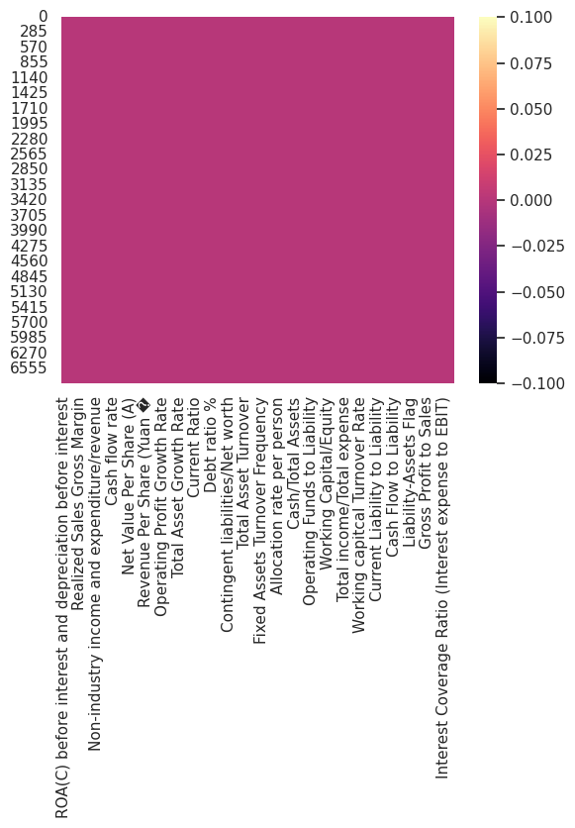
Data preparation/pre-processing
Analyze the values for each column: Get basic summary using df.head, df.info and df.describe
Analyze the type of variables
Check for Missing Values
Check for Duplicates
Check for Outliers
Observation No: 1
df.info()
dtypes: float64(93), int64(2) memory usage: 4.9 MB
float64 93 int64 2 dtype: int64

Slide 15
Data Preparation
df.duplicated(keep=False).sum() =0
No Missing And Duplicate Values Present
EDA

Slide 16
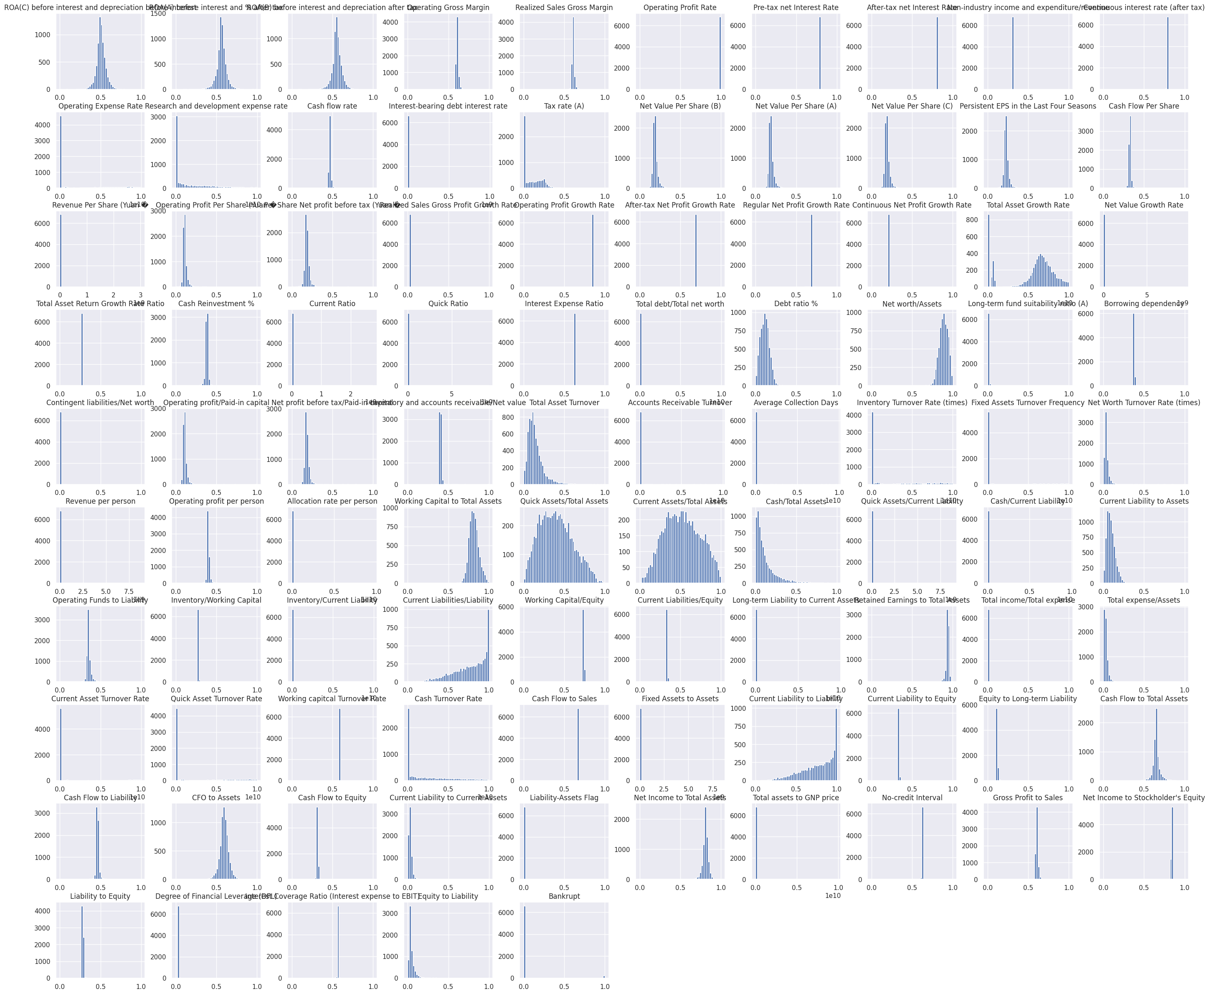

Slide 17
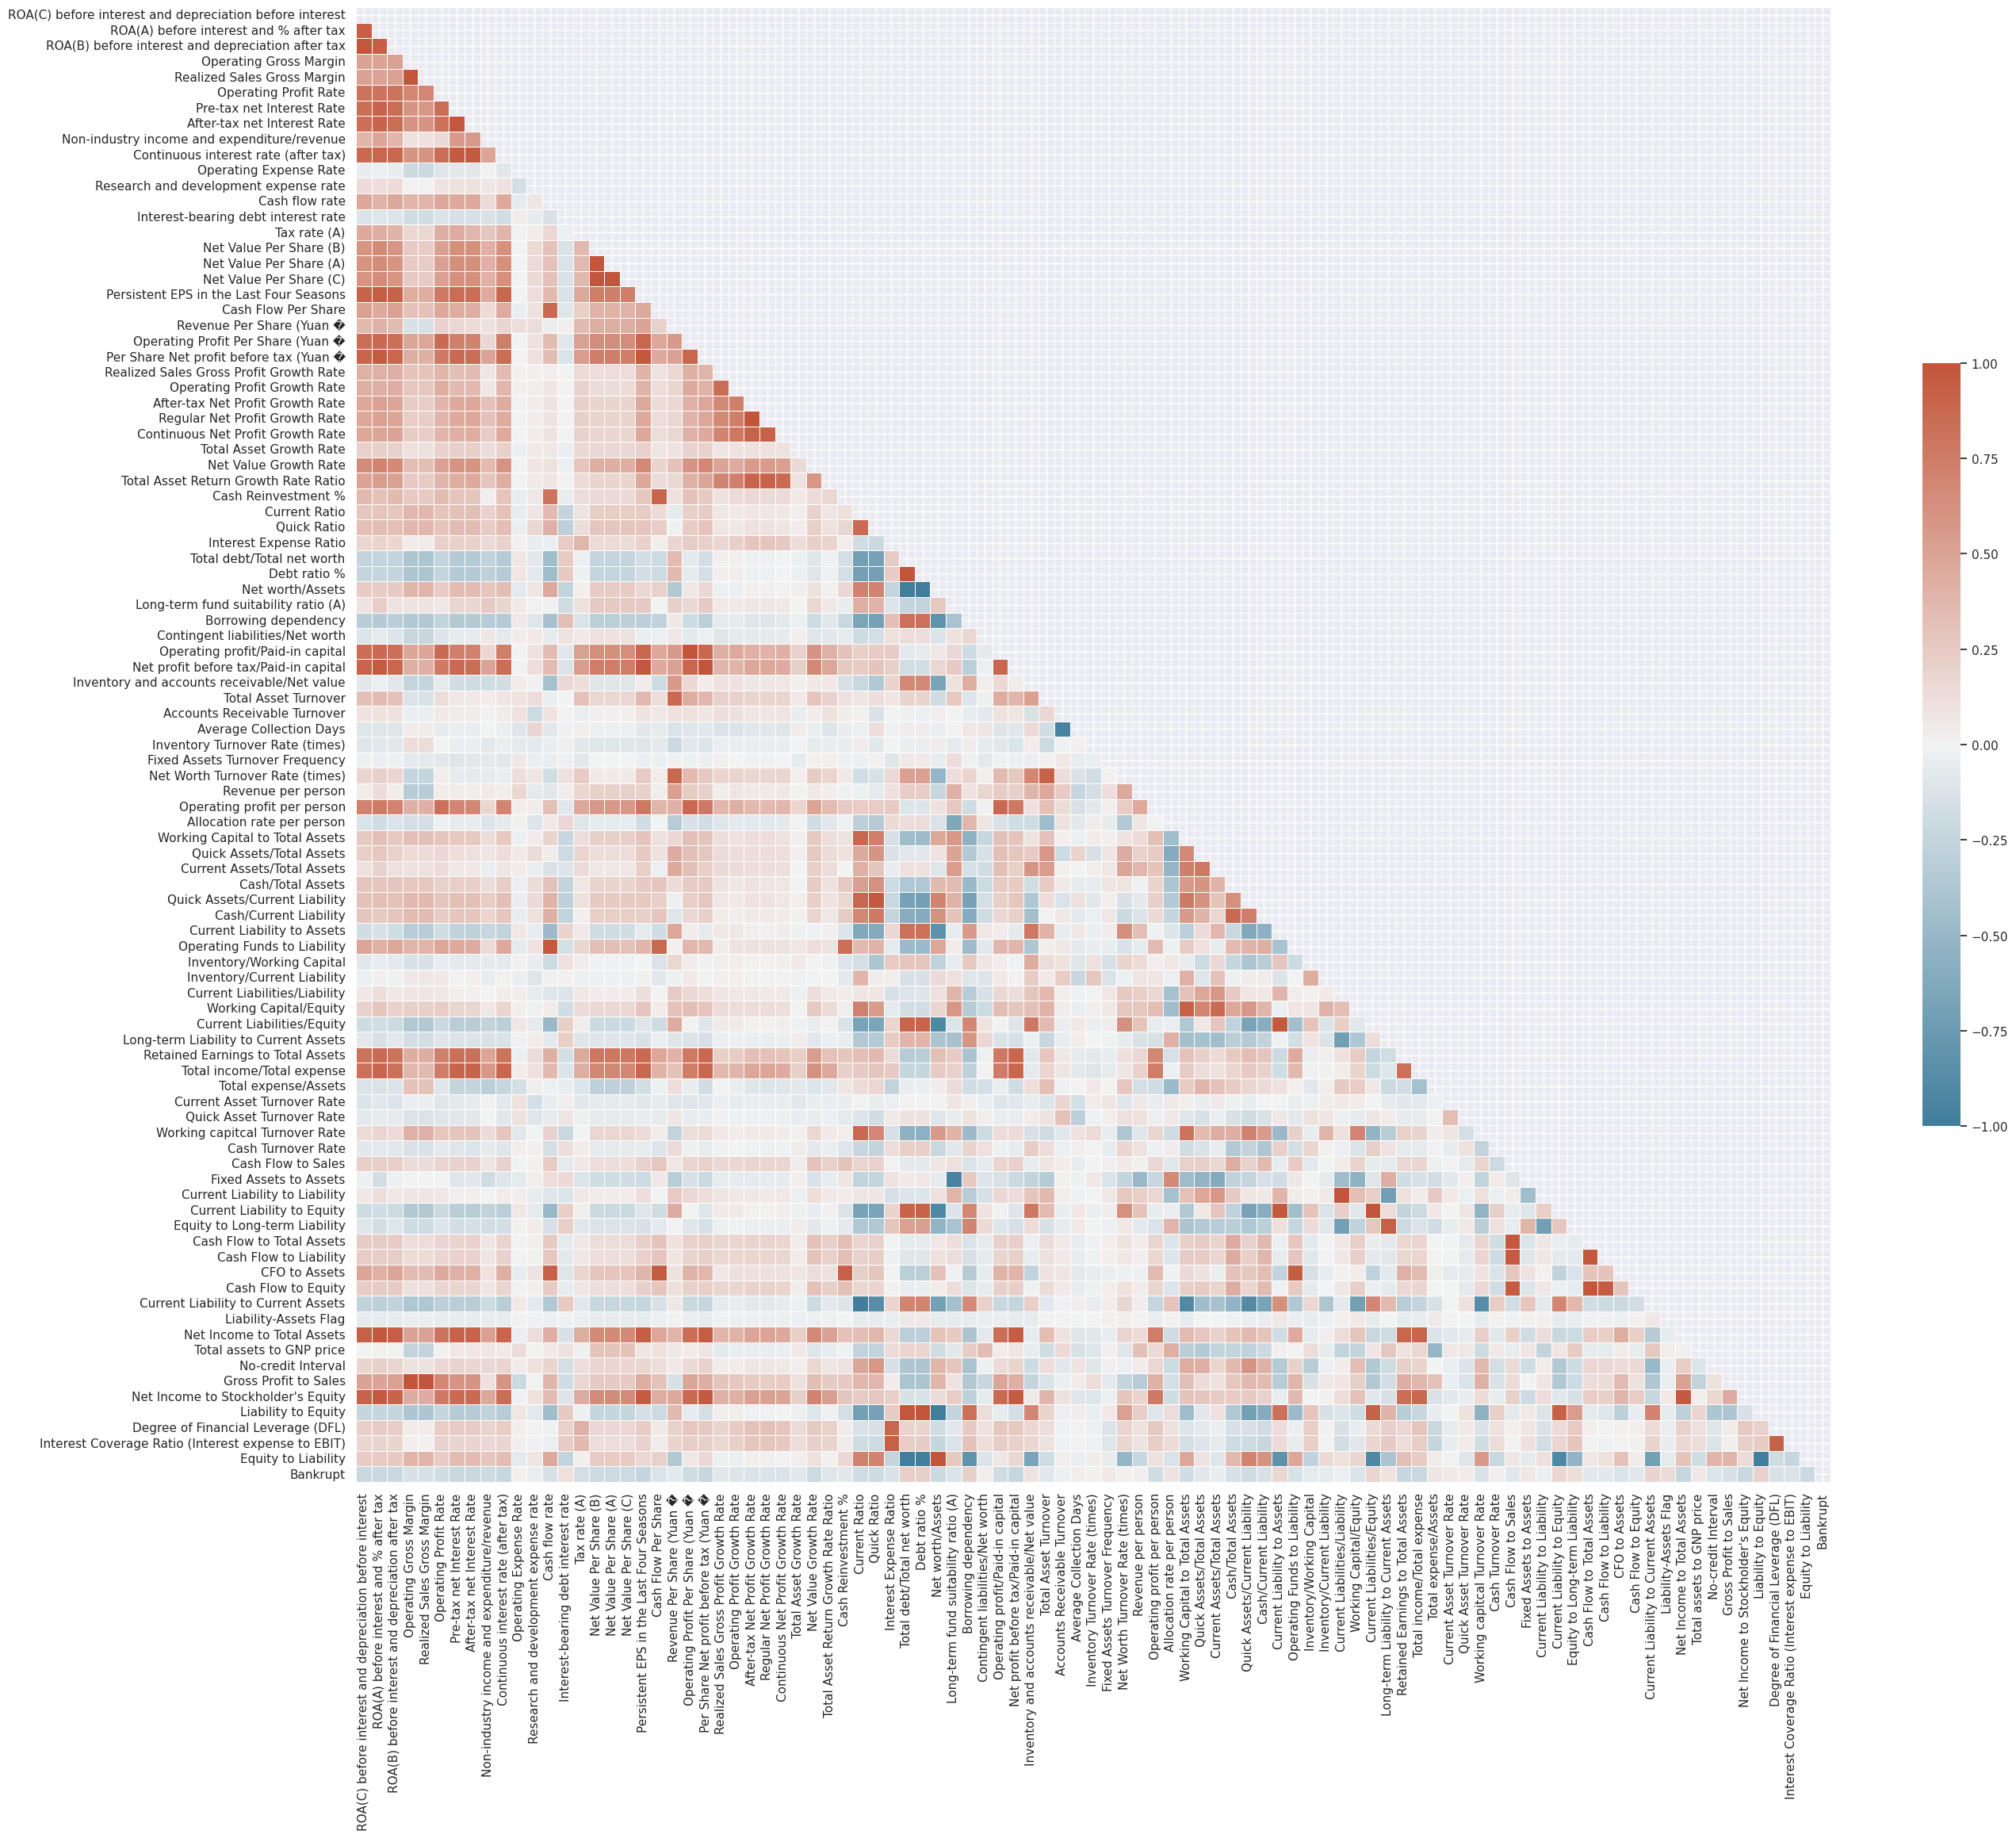

Slide 18
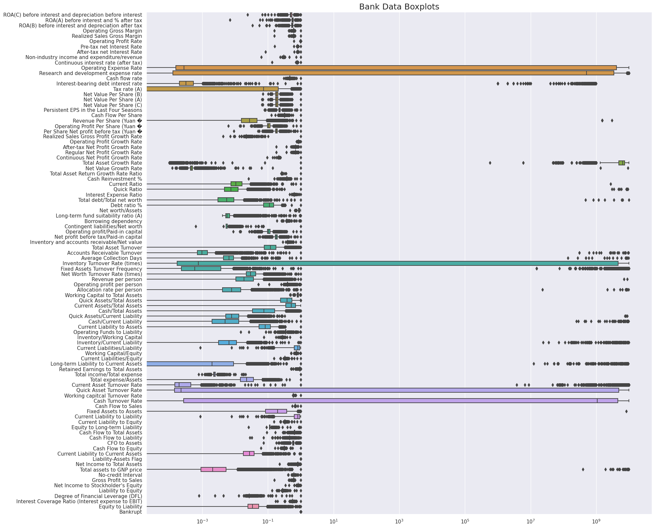

Slide 19
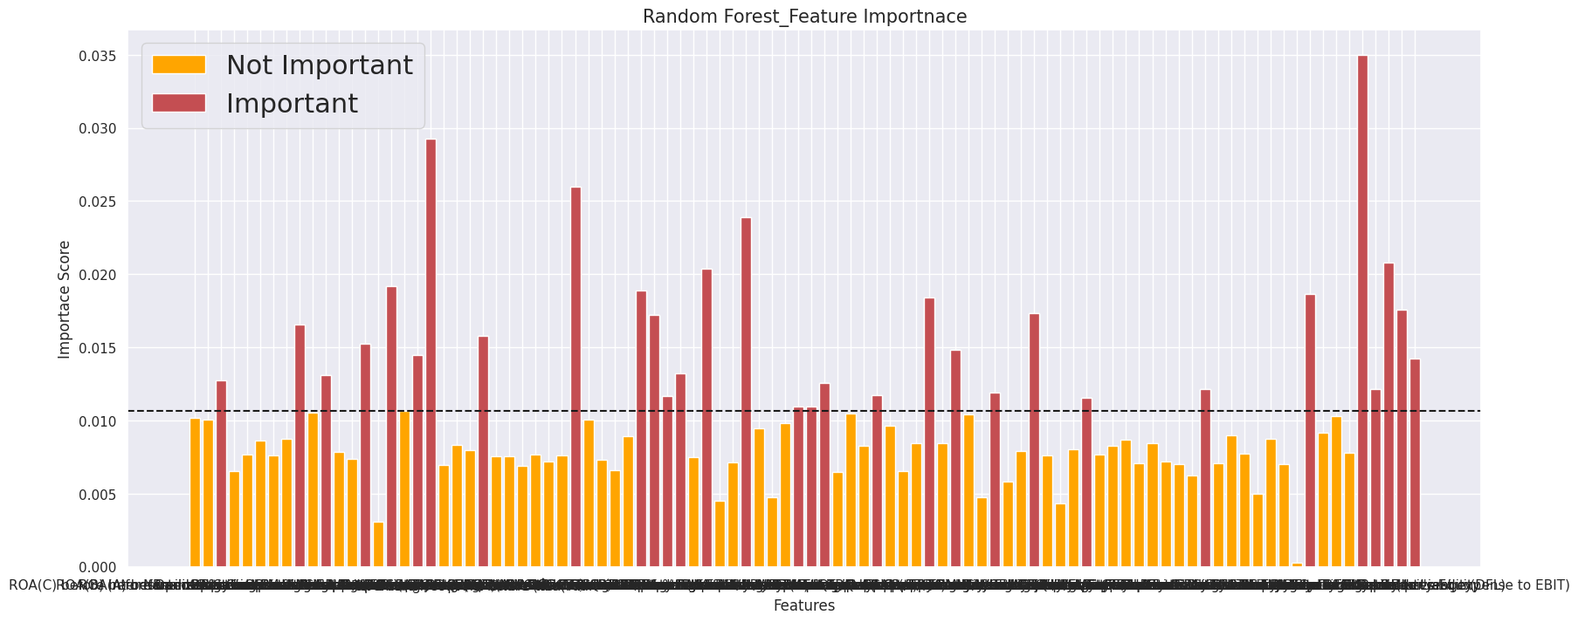
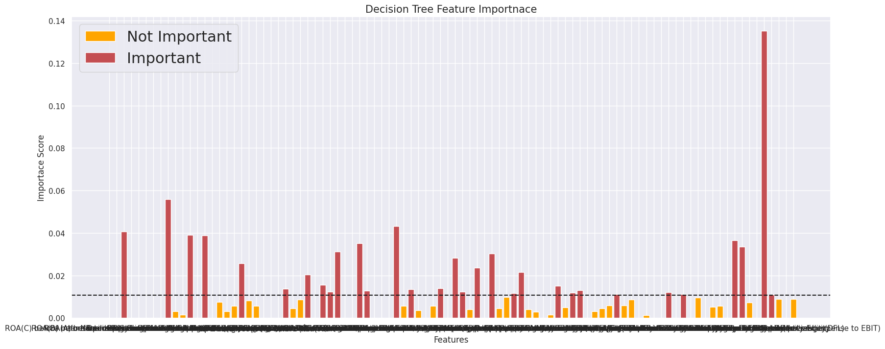
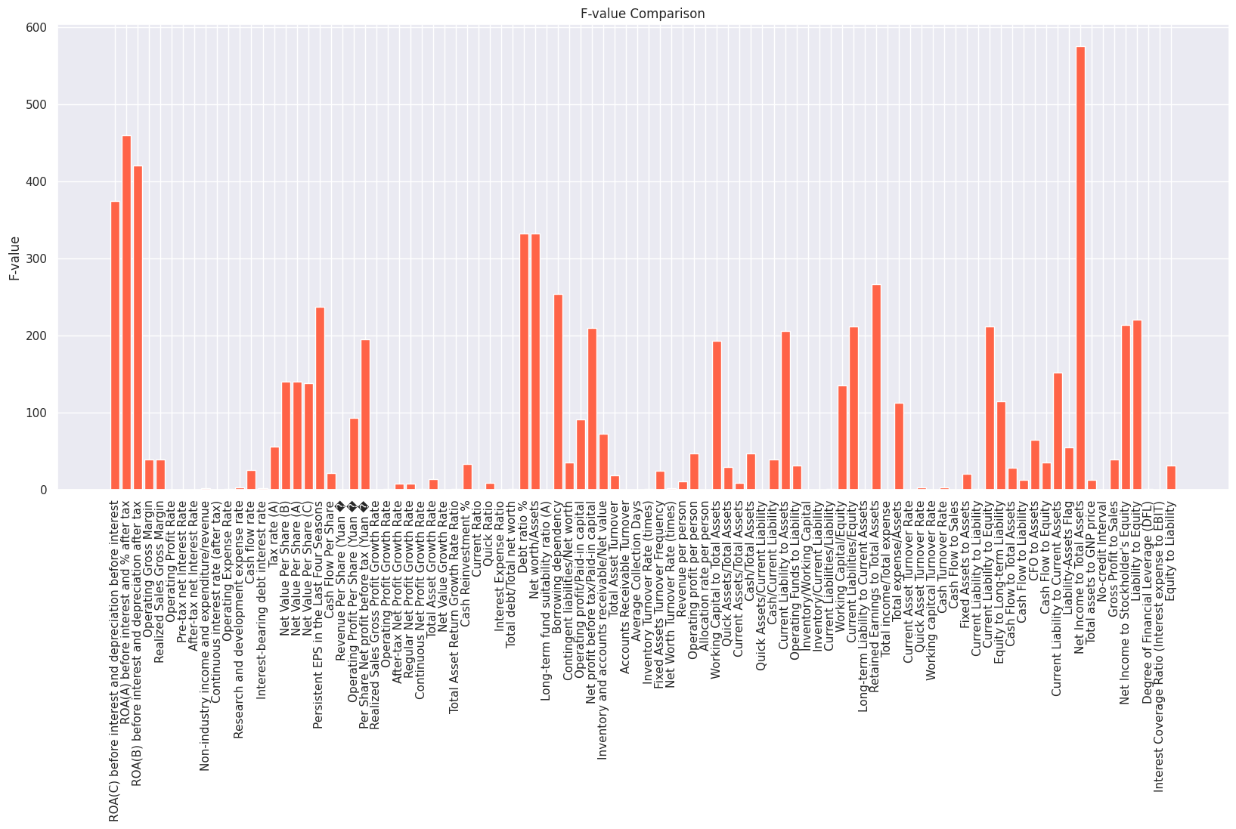
Feature Selection
Model Based Feature Selection
Correlation Model
Random Forest Classifier
Decision Tree Classifier
Annona f-test
Feature Scaling not required

Slide 20
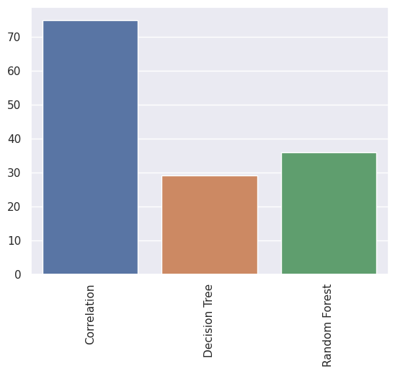

Slide 21
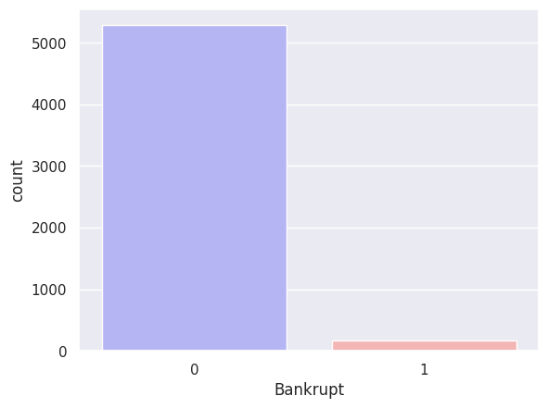
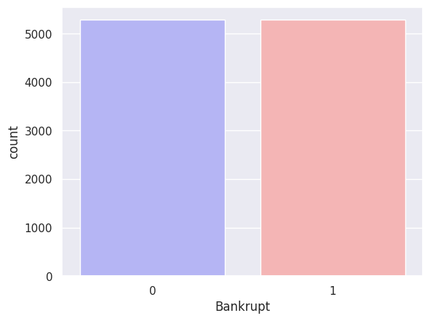
Data Preparation for Modelling
Original Distribution
SMOTE Output

Slide 22

Modelling Phase

Slide 23
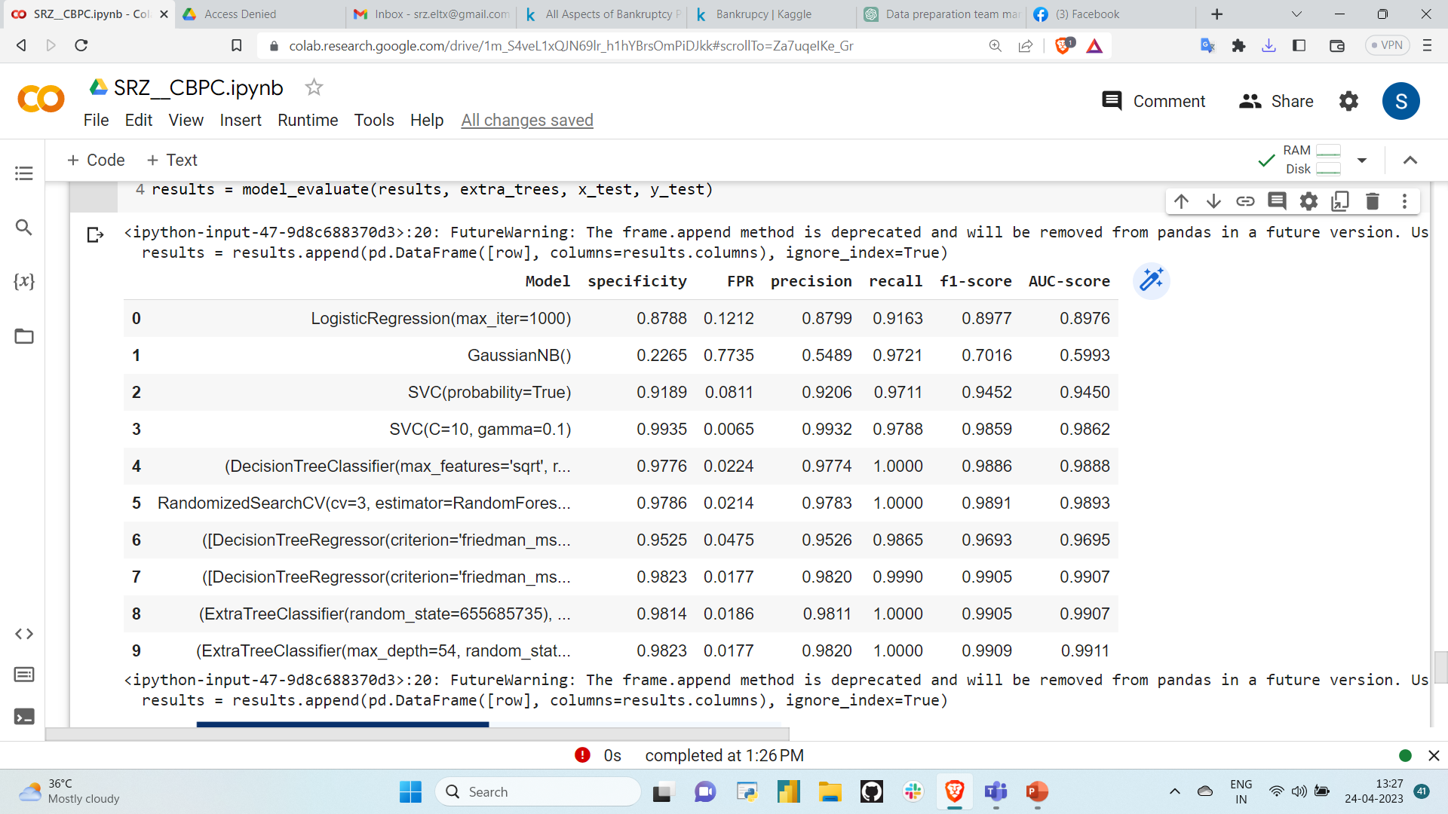
Final Model Performance Comparison Table

Slide 24
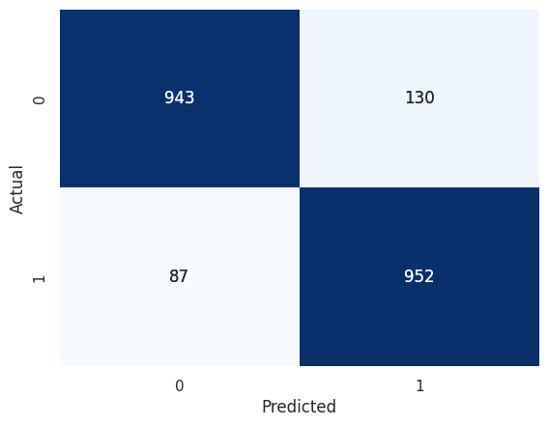
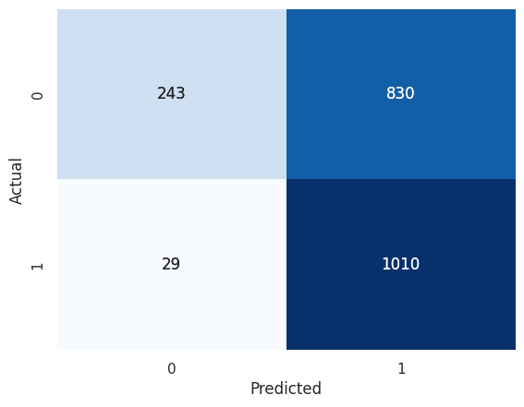

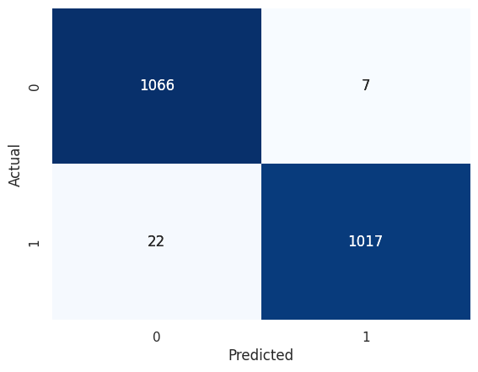
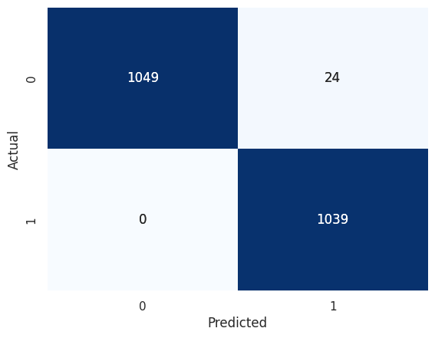
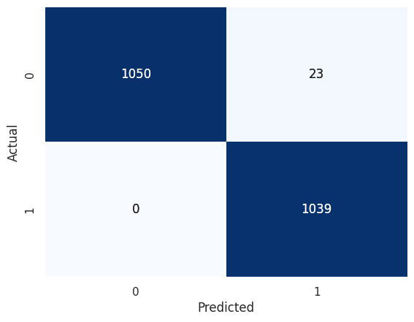


Logistic Regression Classifier
Naïve Bayes
Support Vector
Tuned Support Vector
Random Forest
Tuned Random Forest
Gradient Boost
Tuned Gradient Boost

Slide 25


Extra Trees
Tuned Extra Trees

Slide 26
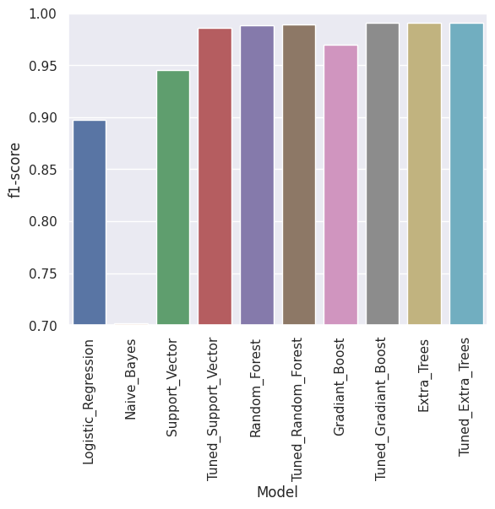
Final Model Performance Comparison Visual

Slide 27
Observations & Conclusion
Missing Values are absent.
No duplicate values found.
Detected outliers using EDA and evaluated using IQR
They are important for prediction so didn't removed.
Data is splitted with 80% train and 20% test followed by scaling
Feature Selection Methods: Four feature selection methods has been implemented
Correlation based feature selection (selected 75 features)
Feature selection using random forest classifier (selected 31 features)
Using Decision Trees Classifier (selected 25 features)
Using Annova f test
Oversampling has been performed using SMOTE technique
Under sampling caused data extent to the very large extend

Slide 28
Observations & Conclusion
The output of SMOTE has been given to the model building and classifiers.
Classifiers Implemented:
Logistic Regression
Gaussian Naive Bayes
Support Vector
Tuned SVM
Random Forest
Tuned Random Forest
Gradient Boost
Tuned Gradient Boost
Extra trees
Tuned Extra trees
Tuned Extra trees classifier performed best amongst all above classifiers. (F-1: 99.09% )
The important features for prediction using gradient boost classifiers printed.

Slide 29
Challenges and Future Scope
Challenges:
The main challenge was to handle outliers and class Imbalance nature of given dataset
Future scope:
Different methods can be incorporate to handle class imbalance.
The Model can be deployed using Streamlit /flask
Future work may involve developing a final, reliable model for classifying live data predictions.
We can also check the performance of prediction using the Altman Z-score.
Higher ensemble techniques and deep learning techniques can be incorporated.

Slide 30


